Slide 1

Chapter 5 Tutorial
Preparing GIS Data using QGIS

Slide 2
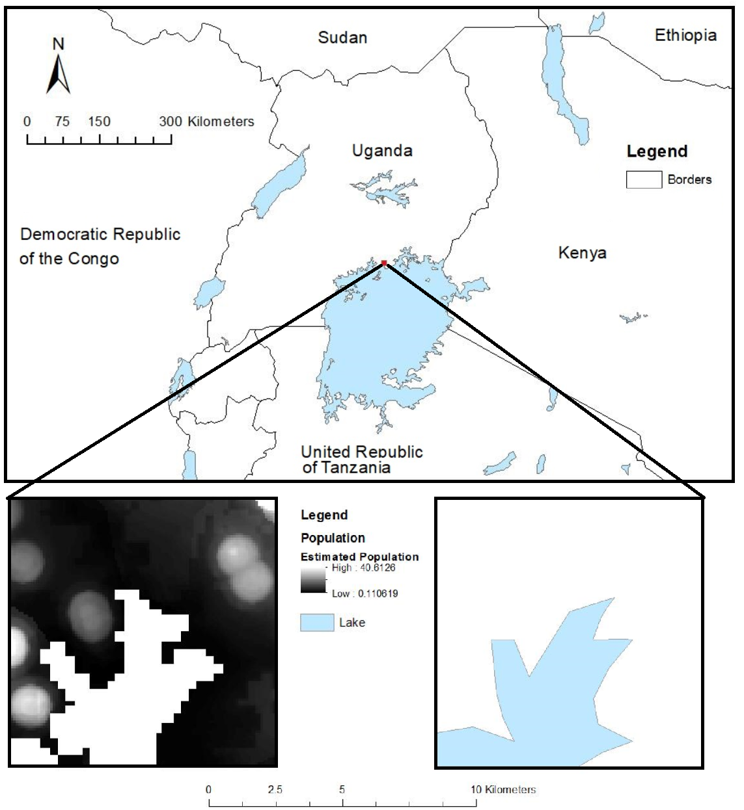
Overview
This tutorial will outline how to prepare some spatial data, ready for loading into NetLogo
The steps are:
Load some population data
Load some environment data
Clip the data to the study area
Load them into the NetLogo ‘UgandaExample’ model (available in the accompanying resources)

Slide 3
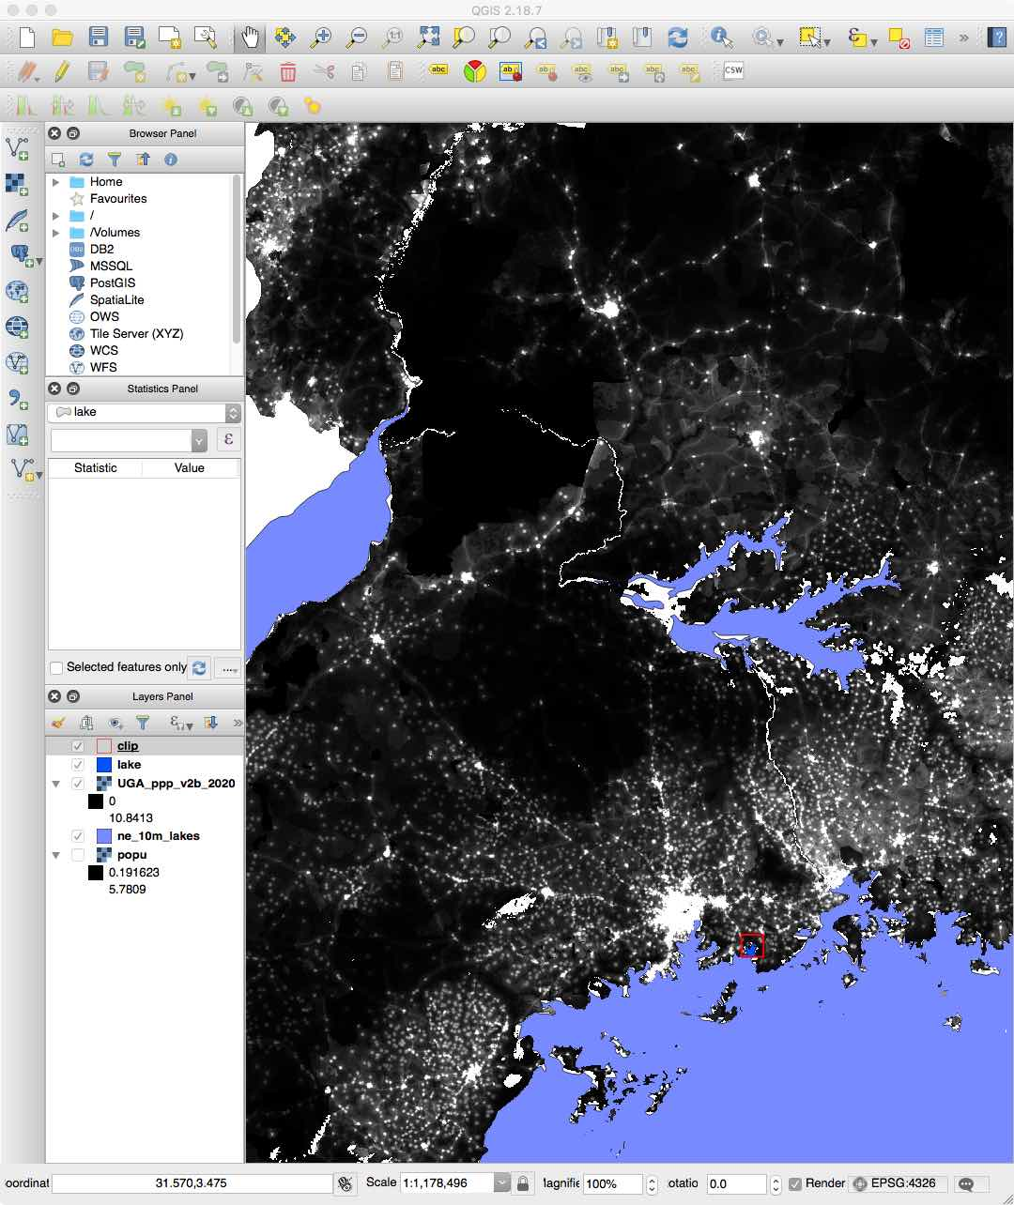

QGIS
QGIS is a free, open source, geographical information system
It is very powerful!
For those who are unfamiliar with it, we recommend doing some of these tutorials first:
This excellent tutorial written by Dr Nik Lomax
QGIS Tutorials & Tips
QGIS Training Material

Slide 4
Performing Spatial Operations
It is common to use a GIS to manipulate spatial data before they are used as input into a GIS.
Here we make use of WorldPop and Natural Earth data
The tutorial will show:
How to load the data sets into QGIS
‘Clip’ them to the study area
Load them into NetLogo
Ultimately the WorldPop data can be used to spawn new agents, and the Natural Earth data can be used to mask out areas of water that cannot hold people.

Slide 5
Load the Raster Population Files
Download and read the raster population files
Also read in the study area file,
We are interested in simulating a part of Uganda, so need the population data:
Download the required population files for Uganda from WorldPop and save them on your computer.
Load them into QGIS using the menu option:
Layer -> Add Layer -> Add Raster Layer
We don’t want to simulate the whole area, so also need to load in a file that contains the study area boundary and ‘clip’ the data to that area
The require file, called ‘clip’, is available in the accompanying resources in the folder Chapter05-GIS/Models/UgandaExample/files/
Load that file into QGIS with
Layer -> Add Layer -> Add Vector Layer

Slide 6
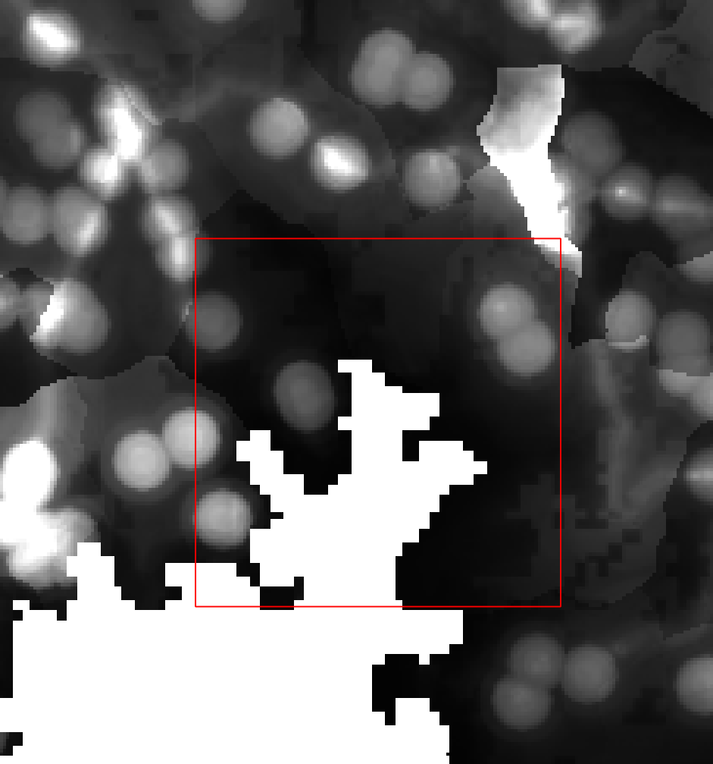
Load the Raster Population Files
After loading the clip file a small square appears over the population data.
It is easier to see this in more detail by zooming into the area that we are going clip
To do this, right-click on the clip file (in the left-hand window) and choose Zoom to Layer.

Slide 7
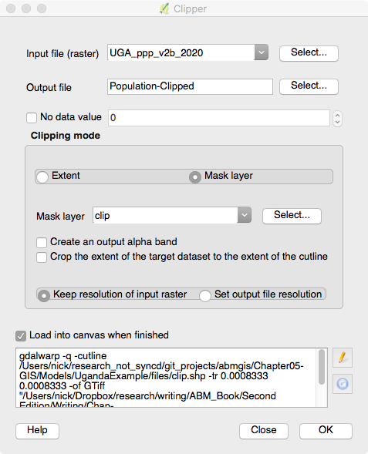
Clip the Raster Population Files
The next step is to cut (‘clip’) the area from the larger population file.
Choose the menu
Raster -> Extraction -> Clipper
And select the the Mask layer option.
We have now the clipped population data for the area that we are interested in!

Slide 8
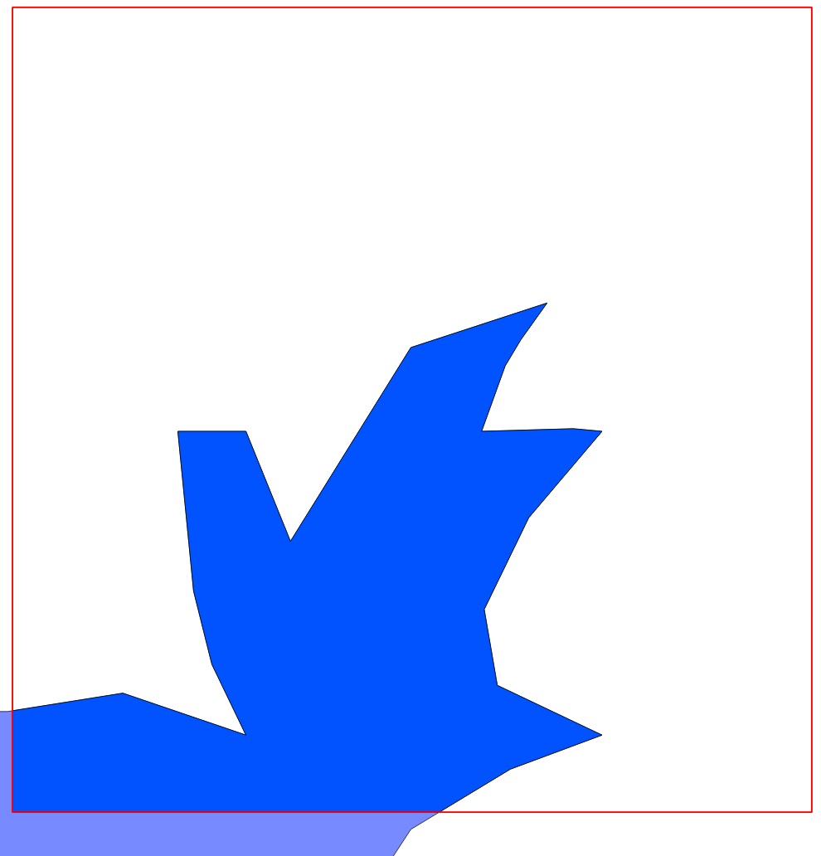
Prepare the Lake Files
Before loading the population data into NetLogo, we need to have a way to tell the model where the local lake is, so that they don’t move into it!
Download the 10 m Lakes GIS vector data file from Natural Earth and save it on your computer
As before, load that file into QGIS
Then clip it using
Vector -> Geoprocessing Tools -> Clip.

Slide 9
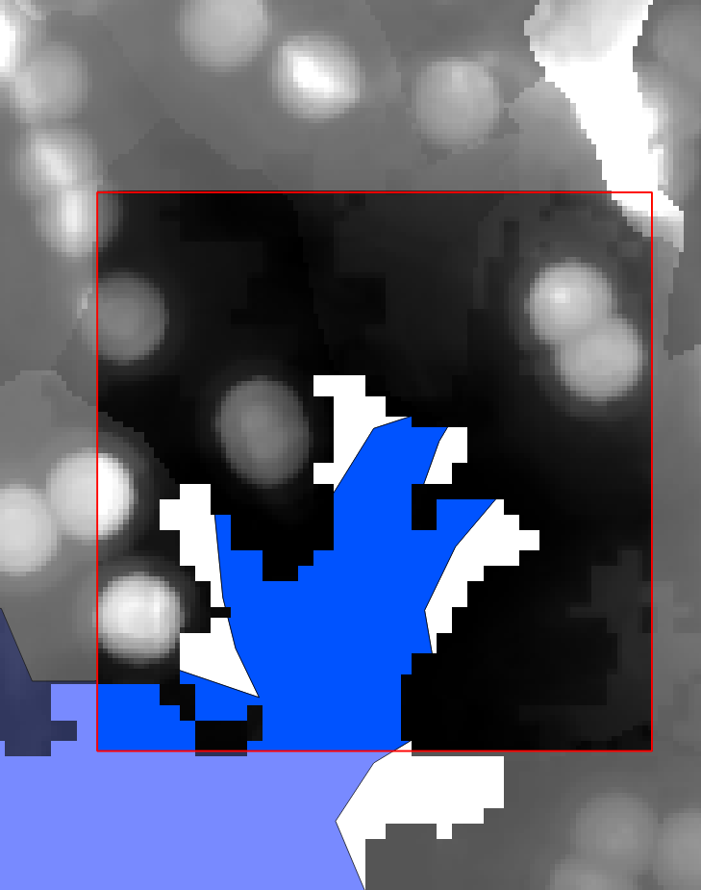
After Loading and Clipping …
We now have the population (in raster format) and the lake (in vector format) clipped to the study region.
The next step is to load these into NetLogo and run the model.

Slide 10
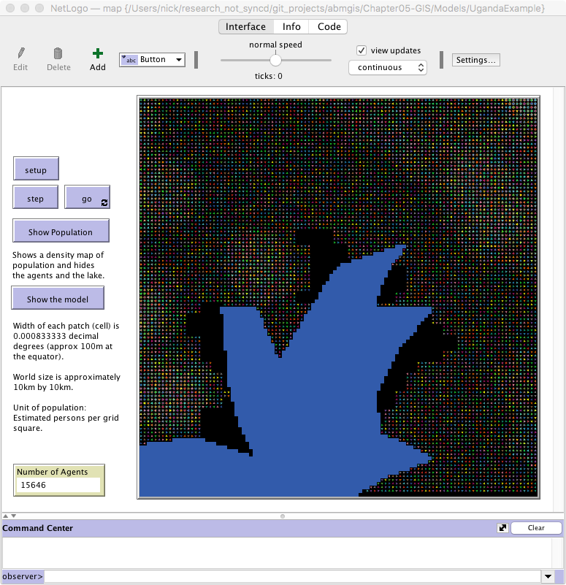
The Uganda NetLogo model
The UgandaExample model, available in the accompanying resources, demonstrates how to load the raster and vector data into QGIS and how to create a simple model.

Slide 11
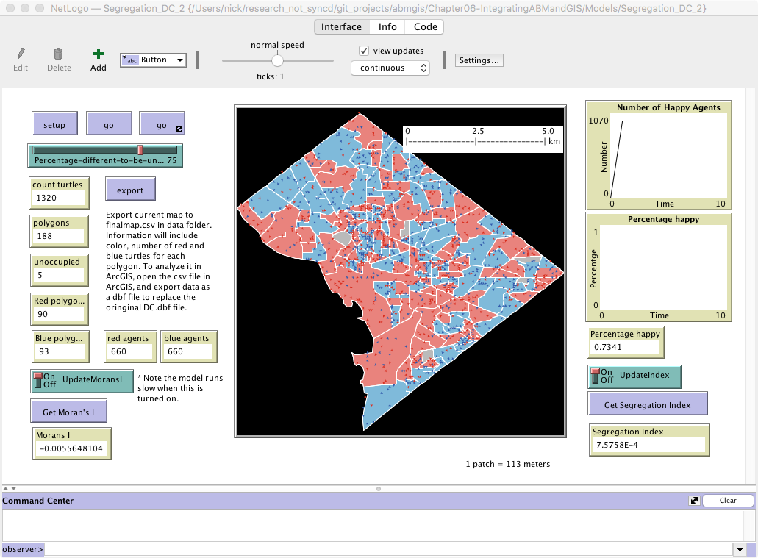
Other things to try…
Chapter 5 of the book also goes through the process of manipulating columns in vector data
It goes through how to load some census population data into NetLogo and create a Schelling-like model of a real area.

